Slide 1
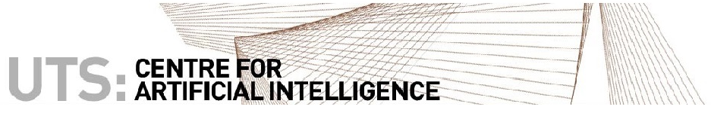
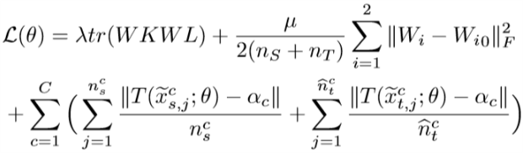
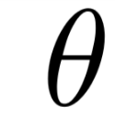
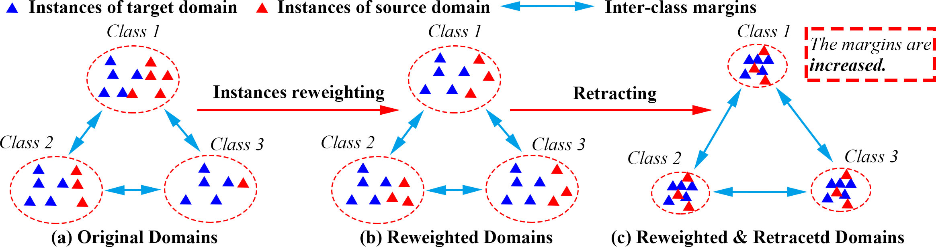
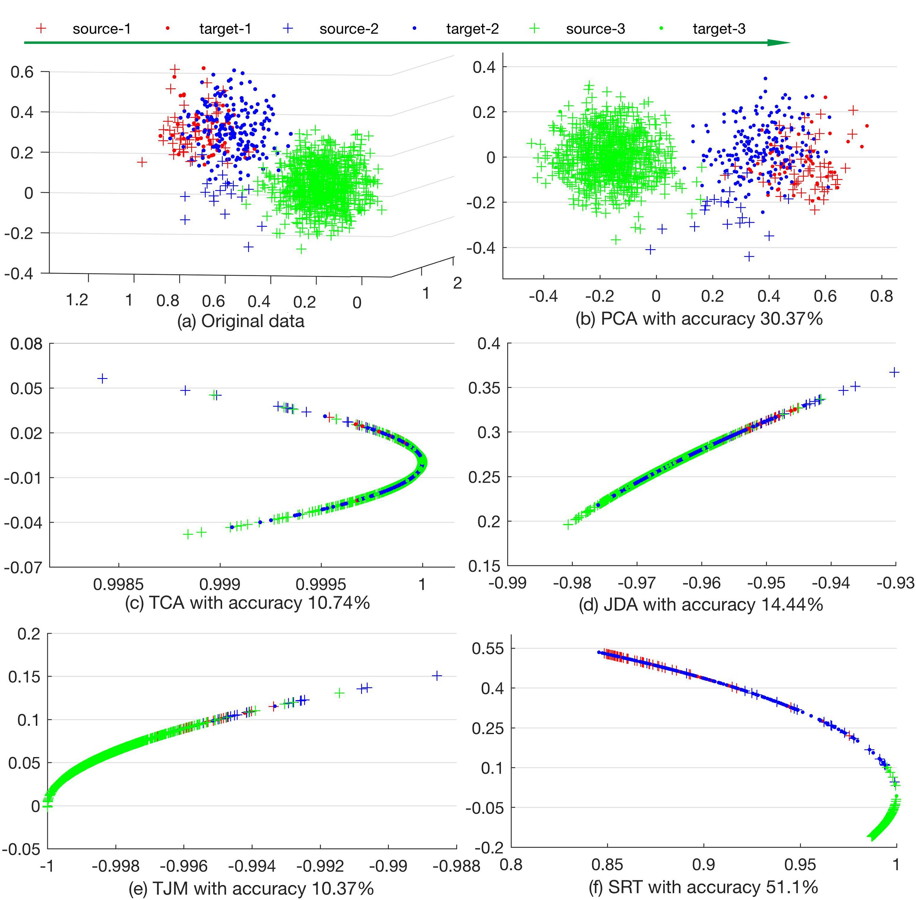
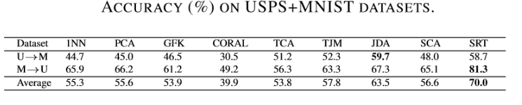
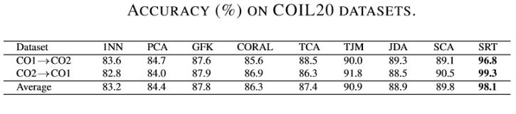
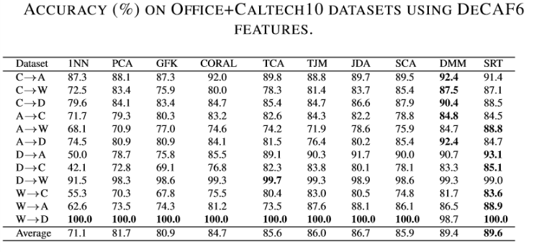
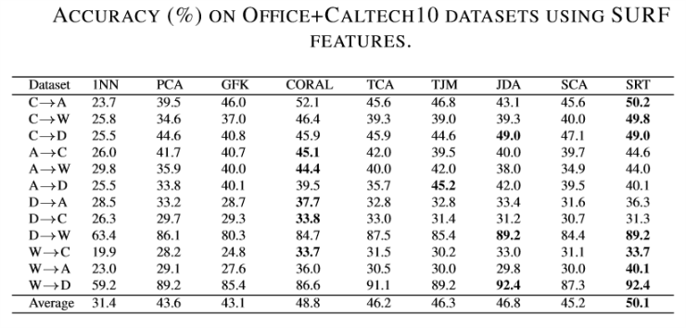
Unsupervised Domain Adaptation
with Sphere Retracting Transformation
Zhen Fang, Jie Lu, Feng Liu, Guangquan Zhang
Centre for Artificial Intelligence, School of Software,
Faculty of Engineering and Information Technology, University of Technology Sydney, Australia
{Zhen.Fang, Feng.Liu-2}@student.uts.edu.au, {Guangquan.Zhang, Jie.Lu}@uts.edu.au
Introduction
Model
Loss function for finding latent space:
Training:
1) use neural network to simulate transformation T;
2) use iterative pseudo label reﬁnement strategy, because we haven’t the labels for target.
Advantages:
Increase the inter-class margins while matching distributions.
Avoid instances belonging to different classes are disordered in the constructed latent space.
Weighting source instances according to a class-speciﬁc weighting strategy and increasing the inter-class margins by reducing the intra-class variations.
How to reweighting source domain ?
For arbitrary class c, the weight Wc is defined as follows:
Wc=Pt(At(c))/Ps(As(c)),
where At(c) is the pre-image of image c for labeling function ft and As(c) is the pre-image of image c for labeling function fs.
We define the reweighted source distribution as WPs.
Theoretical analysis (Reason for the idea):
Theorem 1. Assume the MMD kernel map ϕ is a Lipschitz function with a Lipschitz constant L, and fs = ft (the assumption for DA), if there is a transformation T to make the l2 distance for every class T(As(c)) is smaller than a>0 , then
MMD(T(WPs),T(Pt)) < 2La.
Theorem 1 tells us that if we find a transformation to make the intraclass variations for source domain small, then after transformation T, the reweighted source domain and target domain will also be small enough.
Background:
Supervised Learning: assume training data and testing data have same distribution P(X,Y) .
Real application: training data and testing data have different distributions Ps(X,Y) and Pt(X,Y).
Domain Apaptation (DA): attempt to solve the problem:
1) Different marginal distributions Ps(X) and Pt(X);
2) Similar labeling functions fs(X) and ft(X).
Unsupervised domain adaptation (UDA) : aim to leverage the knowledge in training data (source domain) to improve the performance of tasks in the remaining unlabeled data (target domain) by mitigating the effect of the distribution discrepancy.
Existing approaches resolve UDA mainly:
mapping data into a latent space where the distribution discrepancy between two domains is reduced;
2) reducing the domain shift by weighting the source domain.
However, most of approaches based on method 1) share a common issue that they neglect inter-class margins while matching distributions, which has a signiﬁcant impact on classiﬁcation performance .
Regularization
Distribution matching
Retracting class c for source
Retracting pseudo class c for target
where is the parameters from Neural network.
Basic Ideas for our method:
assigning class-speciﬁc weights for data in the source domain;
minimizing the intraclass variations.
Experiments
TCA, which uses MMD to match distributions
TJM, which jointly matches the feature representations and reweights the source data.
JDA, which jointly mathches the marignal distributions and conditional distributions.
Although the discrepancy between domains is reduced for the TCA, TJM, and JDA, the instances in different clusters are disordered because there may not be a latent feature space to simultaneously reduce domain difference and preserve the original information. However, after the application of SRT, different clusters are separated and most instances in class 3 converge into one cluster.

